Slide 1
Patrick Ryan, Julian Cannon, Clayton Shaver, & Harrison Kuzbyt

Slide 2
Presentation outline
Overview
Architecture
Demonstration
Future
Conclusion

Slide 3
Game Overview
Game goal: A fun way for kids of all ages to learn and interact with elements of the periodic table.
How it works?!
Player inputs how many Elements (Cards) they want play
Game screen with periodic table, score, and current element description are displayed.
Player has to click on the correct element based on the description.
If correct, score increases by 100 and card taken out of the deck next element is displayed
If incorrect, score decreases by 10, card shuffles back into deck, random card displayed. Next time the incorrect card is displayed a new description will be displayed.

Slide 4
Game Overview
Notes:
Fermium Fm 100

Slide 5
Architecture

Slide 6
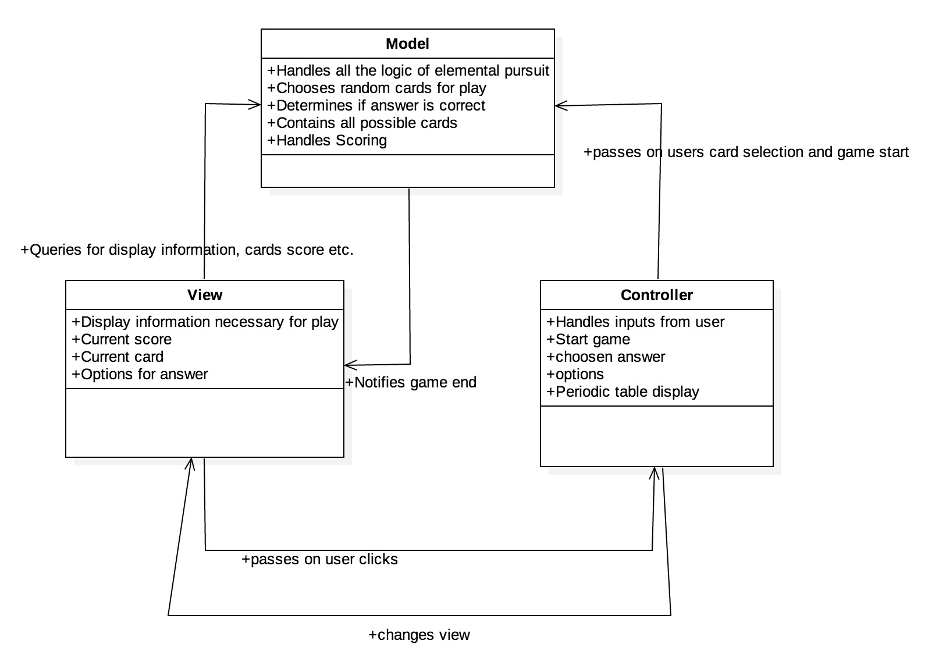
Model View Controller

Slide 7
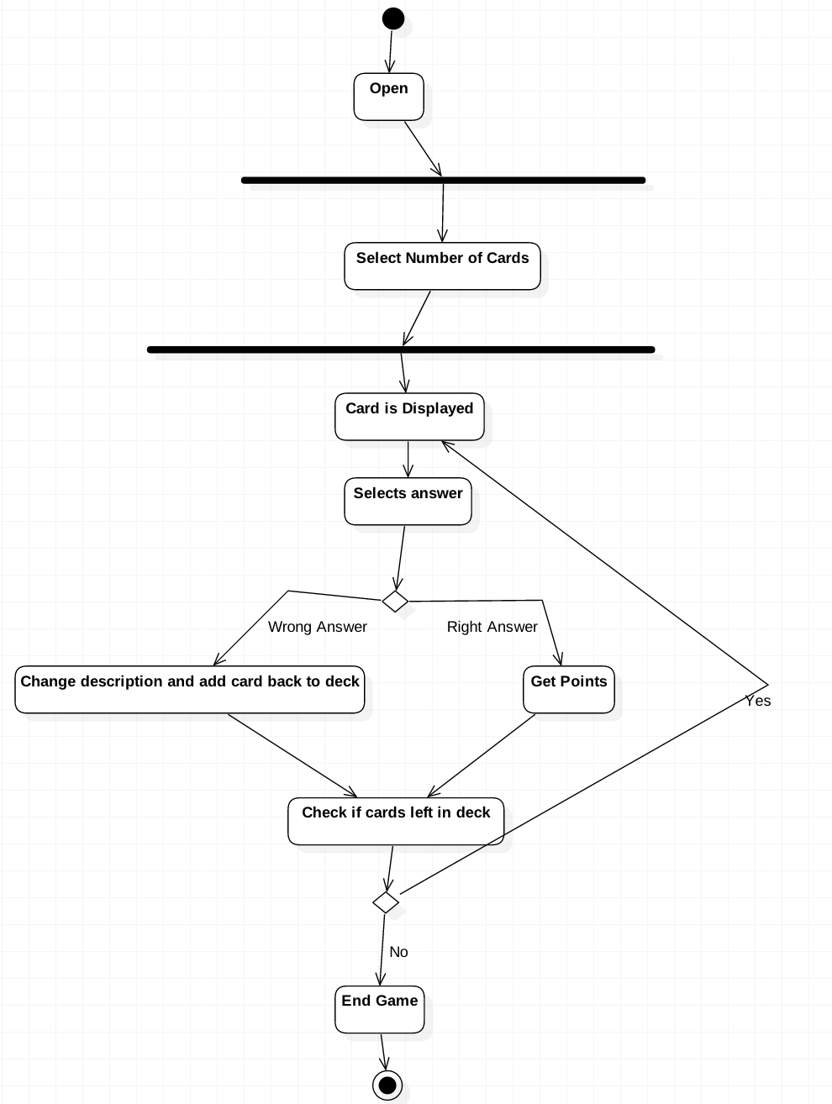
Activity Diagram

Slide 8
Demonstration

Slide 9
Future

Slide 10
Possible Future Plans/Features
Choose a difficulty
Mobile platform
Highscore
Change description database, use at high schools with their material
More GUI features

Slide 11
Conclusion

Slide 12
Conclusion
This project was a great way to experience the software development at every stage in the process
We learned to work in a team and deal with different issues as they came up.
What we would do differently:
Different GUI library (we used libgdx, it got the job done, but was not user friendly)
Overall great experience, thank you for the opportunity to develop this game!

Slide 13
What we are giving you
Source files (code) in a .zip file containing:
the descriptions (text file)
this presentation
jar file (executable)
ReadMe describing how to play the game as well as update element descriptions.

Slide 14
Thank You!

